Slide 1
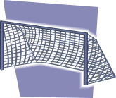




Attacking using Wide Areas
Try to score from entering a wide area (worth 3 goals) – normal score
worth 1 goal

